Slide 1
表示学习（Representation Learning）
机器翻译（Machine Translation）
对话系统（Dialogue System）
自然语言理解
知识图谱（Knowledge Graph）
信息抽取（Information Extraction）
自动摘要（Summarization）
情感分析（Sentiment Analysis）
句法分析（Parsing）
命名实体识别（Name Entity Recognition）

Slide 2
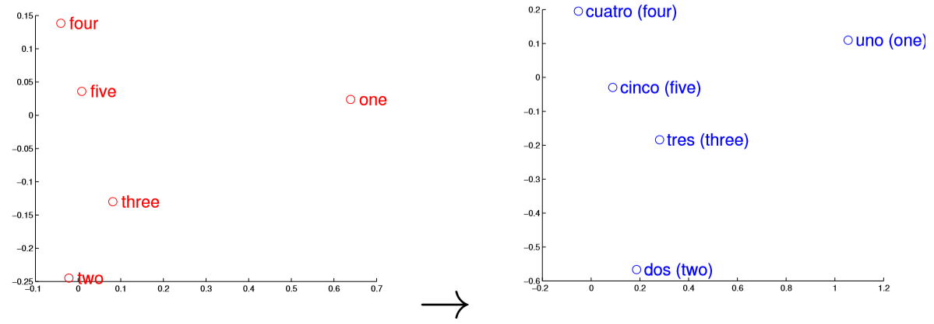
机器翻译
双语字典归纳：
[2013] Exploiting similarities among languages for machine translation
Word Embedding学习，分别学习两种语言的词向量；
用一个种子词典学习两个单语向量空间之间的映射。
[2017] Knowledge distillation for bilingual dictionary induction

Slide 3
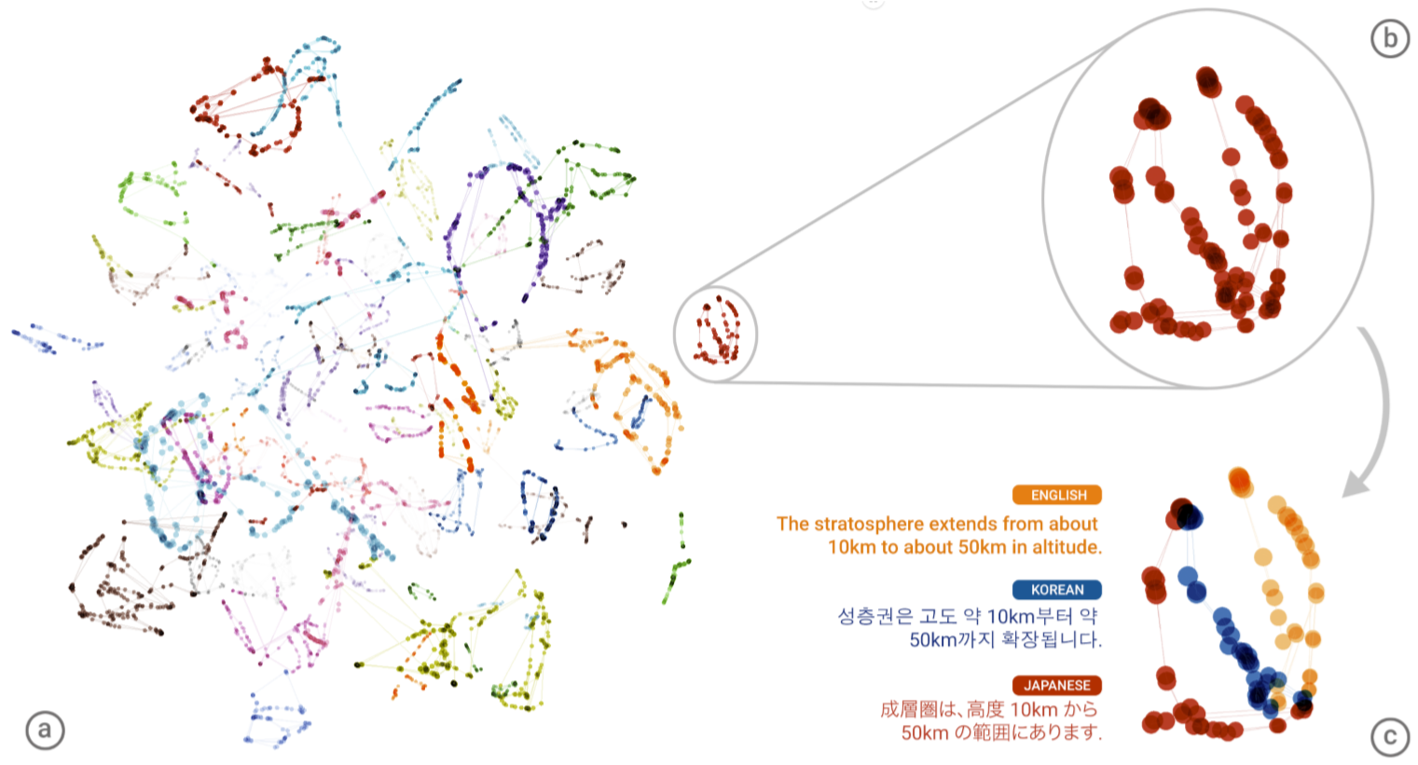
机器翻译
神经机器翻译

Slide 4
机器翻译
[2013] Exploiting similarities among languages for machine translation
[2016] Zero-Resource Translation with Multi-Lingual Neural Machine Translation
[2017] Knowledge distillation for bilingual dictionary induction
[2017] Maximum Expected Likelihood Estimation for Zero-Resource Neural Machine Translation
[2017] Google’s Multilingual Neural Machine Translation System- Enabling Zero-Shot Translation

Slide 5
[2017] Zero-Shot Translation for Indian Languages with Sparse Data
[2017] A teacher-student framework for zero-resource neural machine translation
[2018] Zero-shot cross-lingual classification using multilingual neural machine translation
[2018] Zero-shot dual machine translation
[2018] Universal neural machine translation for extremely low resource languages
[2018] Zero-resource neural machine translation with multi-agent communication game
[2019] Improving zero-shot translation of low-resource languages
[2019] Consistency by agreement in zero-shot neural machine translation
[2019] Improved zero-shot neural machine translation via ignoring spurious correlations
[2019] Cross-lingual Pre-training Based Transfer for Zero-shot Neural Machine Translation

Slide 6
[2019] Evaluating the Supervised and Zero-shot Performance of Multi-lingual Translation Models
[2019] Evaluating the cross-lingual effectiveness of massively multilingual neural machine translation
https://scholar.google.com/scholar?start=80&q=zero+shot+machine+translation&hl=zh-CN&as_sdt=0,5

Slide 7
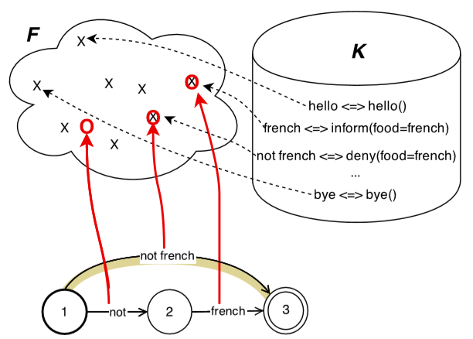
自然语言理解的目标是将一段话转换成可供数据库查询的语义表示。

Slide 8
自然语言理解
[2015] Zero-shot semantic parser for spoken language understanding
[2015] A model of zero-shot learning of spoken language understanding
[2017] Zero-shot Learning for Natural Language Understanding using Domain-Independent Sequential Structure and Question Types

Slide 9
[2015] Online adaptative zero-shot learning spoken language understanding using word-embedding
[2017] Towards zero-shot frame semantic parsing for domain scaling
[2017] Adversarial bandit for online interactive active learning of zero-shot spoken language understanding
[2018] Decoupling structure and lexicon for zero-shot semantic parsing
[2019] Zero-shot adaptive transfer for conversational language understanding
[2019] Cross-lingual alignment of contextual word embeddings, with applications to zero-shot dependency parsing
[2019] Improving Zero-shot Translation with Language-Independent Constraints
[2019] Zero-Shot Semantic Parsing for Instructions

Slide 10
实体抽取
[2014] Zero-shot entity extraction from web pages
[2016] Label embedding for zero-shot fine-grained named entity typing
[2018] Toward zero-shot entity recognition in task-oriented conversational agents
[2019] Zero-shot open entity typing as type-compatible grounding
[2019] Description-Based Zero-shot Fine-Grained Entity Typing
https://scholar.google.com/scholar?start=70&q=zero+shot+entity+extraction+&hl=zh-CN&as_sdt=0,5

Slide 11
其它
自然语言生成
[2017] Domain Transfer for Deep Natural Language Generation from Abstract Meaning Representations
标题生成
[2018] Zero-shot Cross-Lingual Neural Headline Generation
摘要生成
[2019] Zero-Shot Cross-Lingual Abstractive Sentence Summarization through Teaching Generation and Attention
问题生成
[2018] Zero-shot question generation from knowledge graphs for unseen predicates and entity types
对话生成
[2018] Zero-shot dialog generation with cross-domain latent actions

Slide 12
文档话题分类
[2019] Toward any-language zero-shot topic classification of textual documents
意图分类/理解
[2018] Zero-shot User Intent Detection via Capsule Neural Networks
[2019] Zero Shot Intent Classification Using Long-Short Term Memory Networks
[2016] Zero-shot learning of intent embeddings for expansion by convolutional deep structured semantic models
[????] Zero-shot learning of user intent understanding by Convolutional Neural Networks
语义分类
[2013] Zero-shot learning for semantic utterance classification
[2019] Integrating semantic knowledge to tackle zero-shot text classification
[2018] Multilingual word embedding for zero-shot text classification
关系分类
[2018] Zero-shot Relation Classification as Textual Entailment

Slide 13
槽填充
[2019] Robust Zero-Shot Cross-Domain Slot Filling with Example Values
文档检索
[2015] Image-mediated learning for zero-shot cross-lingual document retrieval
关系抽取
[2017] Zero-shot relation extraction via reading comprehension
[2018] Zero-shot sequence labeling: Transferring knowledge from sentences to tokens
[2020] Parasitic Neural Network for Zero-Shot Relation Extraction
实体属性抽取
[2019] Identifying Entity Properties from Text with Zero-shot Learning
[2020] MZET: Memory Augmented Zero-Shot Fine-grained Named Entity Typing
类别属性关联
[2016] Recovering the missing link: Predicting class-attribute associations for unsupervised zero-shot learning

Slide 14
实体连接
[2019] Zero-shot neural transfer for cross-lingual entity linking
知识图谱
[2018] Multi-label zero-shot learning with structured knowledge graphs
[2018] Zero-shot question generation from knowledge graphs for unseen predicates and entity types

Slide 15
其他
[2017] Zero-shot activity recognition with verb attribute induction
[2017] WOAH: Preliminaries to Zero-shot Ontology Learning for Conversational Agents
[2019] Zero-Shot Cross-Lingual Opinion Target Extraction

Slide 16
其他（非NLP）
其他
[2015] Injecting logical background knowledge into embeddings for relation extraction
[2015] Zero-shot learning via semantic similarity embedding
[2015] Ridge regression, hubness, and zero-shot learning
[2015] Hubness and pollution: Delving into cross-space mapping for zero-shot learning
[2016] Representation learning of knowledge graphs with entity descriptions
[2017] Answering Visual-Relational Queries in Web-Extracted Knowledge Graphs
[2017] Unsupervised neural machine translation
[2018] Stacked semantics-guided attention model for fine-grained zero-shot learning
[2018] Meta-learning for low-resource neural machine translation
[2018] A generative adversarial approach for zero-shot learning from noisy texts

Slide 17
[2018] Multi-modal cycle-consistent generalized zero-shot learning
[2019] Language models are unsupervised multitask learners
[2019] Generative dual adversarial network for generalized zero-shot learning
[2019] Residual Graph Convolutional Networks for Zero-Shot Learning
[2020] Rotation, Translation, and Cropping for Zero-Shot Generalization
[2020] Zero-Shot Cross-Lingual Transfer with Meta Learning
[????] Near or Far, Wide Range Zero-Shot Cross-Lingual Dependency Parsing
强化学习
[2017] Zero-shot task generalization with multi-task deep reinforcement learning
对抗信念匹配
[2019] Zero-shot knowledge transfer via adversarial belief matching

